Slide 1
실습 03-UDP
휴먼지능정보공학과
201810760 김상경

Slide 2
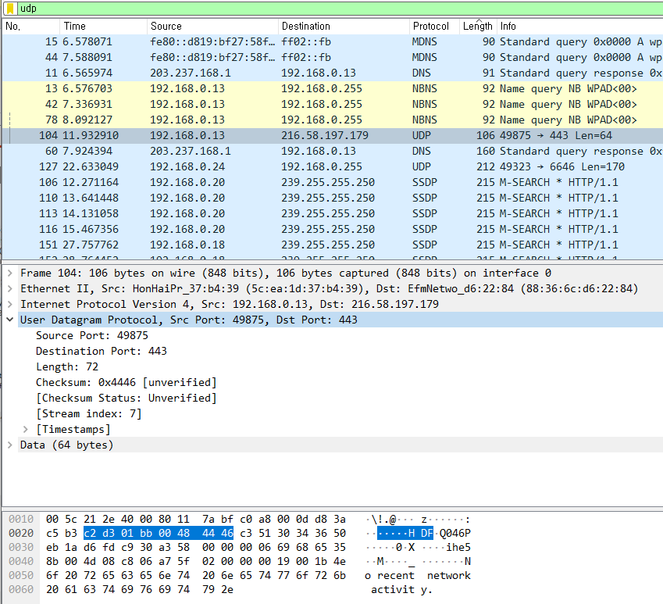
1) Select one UDP packet from your trace. From this packet, determine how many fields there are in the UDP header. Name these fields.
Source Port, Destination Port, Length, Checksum
총 4fields로 구성 되어있다.

Slide 3
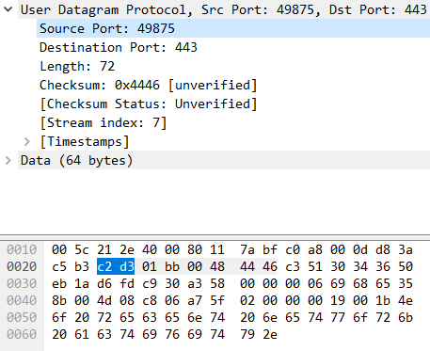
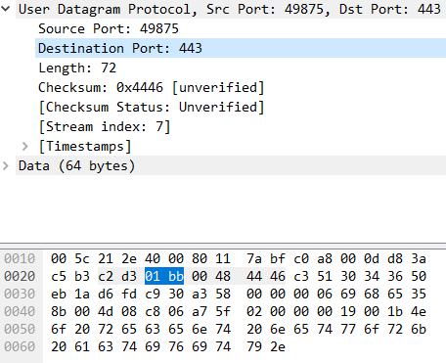
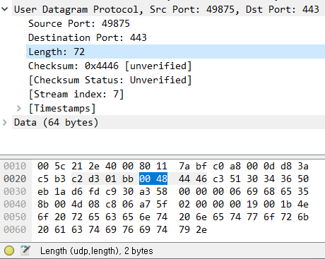
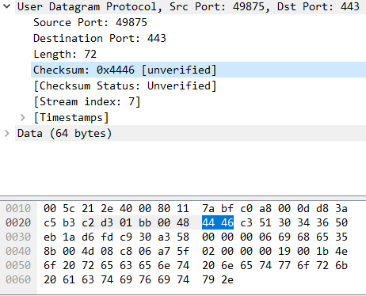
2) Find out the length (in bytes) of each of the UDP header fields.
Source Port : 2Bytes
Destination Port : 2Bytes
Length : 2Bytes
Checksum : 2Bytes

Slide 4
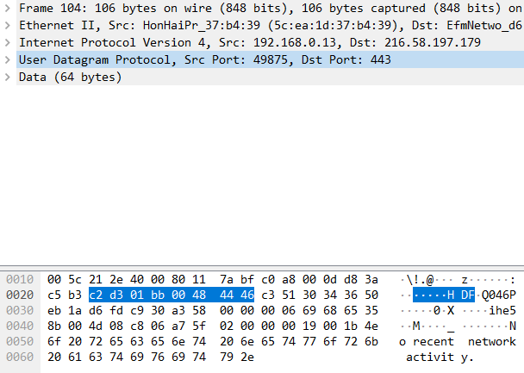
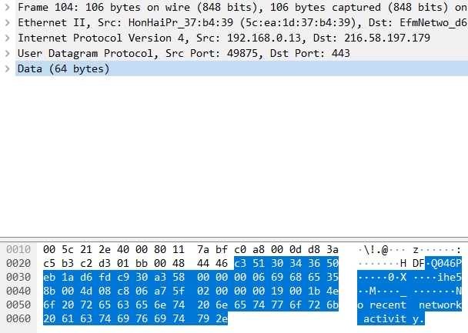
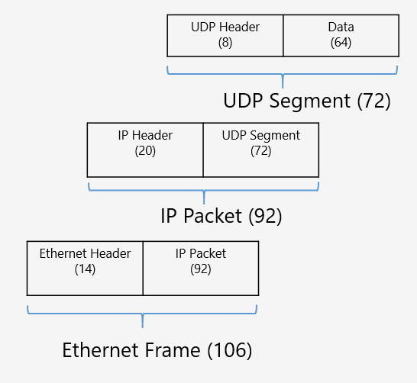
3) The value in the Length field is the length of what? Verify your claim with your captured UDP packet.
8Bytes
64Bytes
UDP Header(8Bytes)와
Data(64Bytes) field의 길이의 합(= UDP Segment의 길이)이 Length field의 value이다.

Slide 5
4) What is the maximum number of bytes that can be included in a UDP payload? (Hint: the answer to this question can be determined by your answer to 2. above)
Length : 2Bytes
2Bytes = 16bits
2^16 – 1 = 65,535 가 Length의 최대 허용 Bytes 값
65,535 – 8 = 65,527
왜냐하면 UDP header의 길이가 8이기 때문.

Slide 6
5) What is the largest possible source port number? (Hint: see the hint in 4.)
Source Port : 2Bytes
2Bytes = 16bits
2^16 – 1 = 65,535

Slide 7
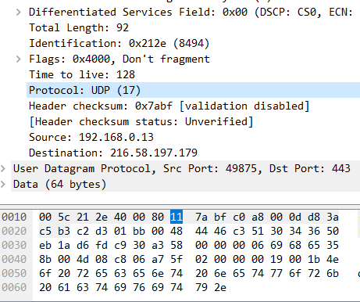
6) What is the protocol number for UDP? Give your answer in both hexadecimal and decimal notation. To answer this question, you’ll need to look into the Protocol field of the IP packet containing this UDP segment.
10진수 표기법 : 17
16진수 표기법 : 11

Slide 8
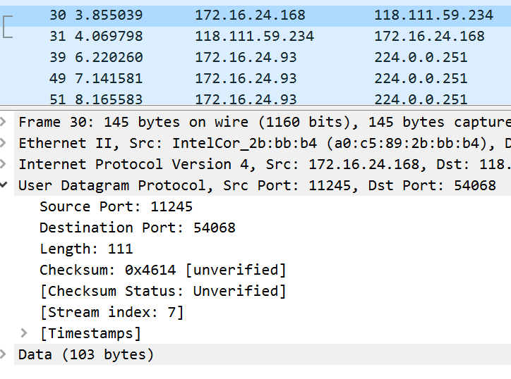
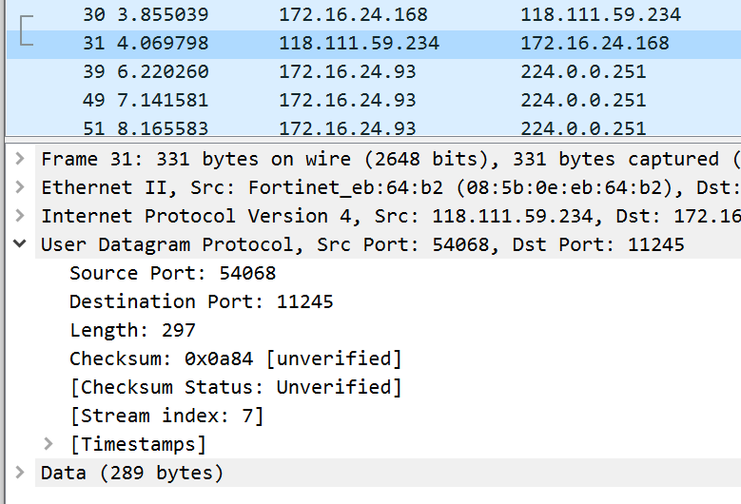
7) Examine a pair of UDP packets. (your host sends the first UDP packet and the second UDP packet is a reply to this first UDP packet.) (Hint: for a second packet to be sent in response to a first packet, the sender of the first packet should be the destination of the second packet). Describe the relationship between the port numbers in the two packets.
First packet의 Source Port와 Second Port의 Destination Port의 값이 11245로 같고,
First packet의 Destination Port 와 Second Port의 Source Port 의 값이 54068로 같음을 알 수 있다.

